Slide 1
802.11 MEDIUM CONTENTION
G. Naresh

Slide 2
CONTENTS
CSMA
Distributed Coordination function
Interframe Spaces
Random Backoff
Frame Transmission

Slide 3
CSMA
Idea: The chance of collision can be reduced if a station senses the medium before trying to use it.
Persistent Methods
  1 – Persistent Method
  Nonpersistent Method
  p – Persistent Method
CSMA/CD
CSMA/CA

Slide 4
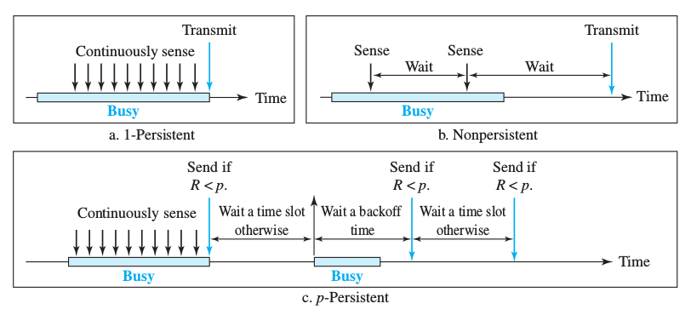
Persistent Methods

Slide 5
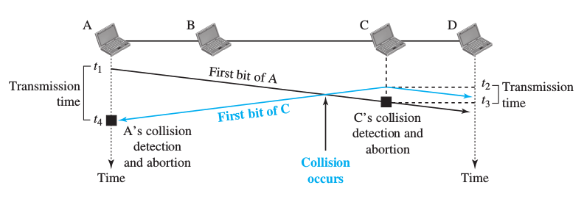
CSMA/CD

Slide 6
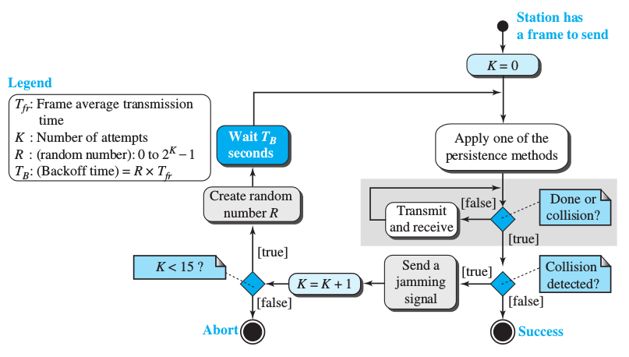
CSMA/CD Flowchart

Slide 7
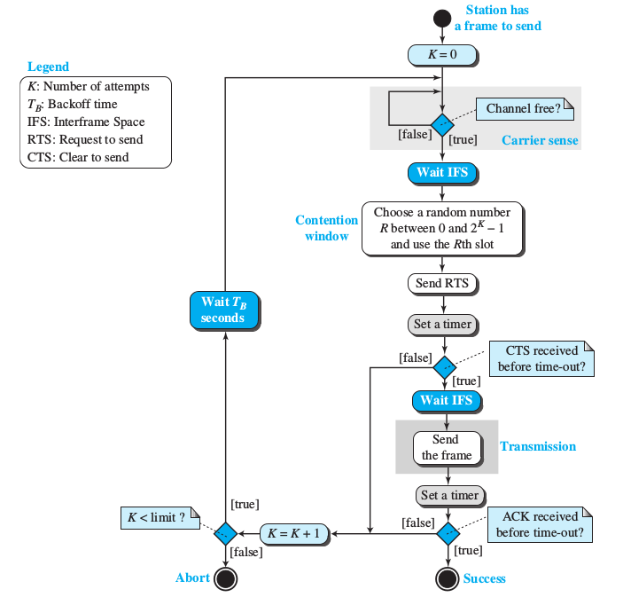
CSMA/CA Flowchart

Slide 8
Distributed Coordination Function
The four main components of DCF:
  Carrier sense
  Duration/ID field
  Interframe space
  Random backoff timer
Physical Carrier Sense (Clear Channel Assessment)
  ED (Energy Detection)
  CS (Carrier Sense)
Virtual Carrier Sense (Network Allocation Vector)
  Duration value set in each frame’s MAC header where other stations set their NAV to this if the sense medium is busy.

Slide 9
Interframe Spaces
The IFS is a quiet period that APs and stations must wait before any 802.11 frame transmission.
The purpose of an IFS is both to provide a buffer between frames to avoid interference as well as to add control and to prioritize frame transmissions.
The length of the IFS time is depends on previous frame type, following frame type, access category, coordination function in use & PHY type as well.
Short Interframe Space (SIFS)
  It is the shortest IFS, has highest level of priority.
Reduced Interframe Space (RIFS)
  RIFS were introduced with 802.11n to improve efficiency for transmissions to the same receiver in which a SIFS-separated response is not required, such as a transmission burst (CFB-Contention Free Burst).

Slide 10
Contd...
DCF Interframe Space (DIFS)
  DIFS = SIFS + 2 x SlotTime
Extended Interframe Space (EIFS)
  EIFS (in DCF) = SIFS + DIFS + ACK_Tx_Time
  EIFS 802.11b/g/n devices using DSSS = 364μS
  EIFS 802.11g/n devices using OFDM = 160μS
  EIFS 802.11a/n devices (5GHz) = 160μS
  EIFS (in EDCA) = SIFS + AIFS[AC] + ACK_Tx_Time
Arbitration Interframe Space (AIFS)
  Shall be used by the QoS STA's.
  AIFS[AC] = AIFSN[AC] × SlotTime + SIFSTime
PCF Interframe Space (PIFS)
  Used by STAs during the contention-free period (CFP) in PCF mode.
  PIFS = SIFS + SlotTime

Slide 11
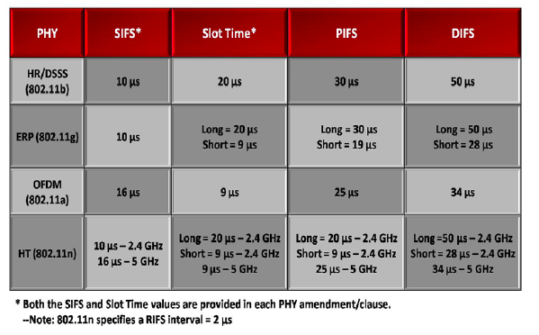
Contd...

Slide 12
Random backoff
An 802.11 station may contend for the medium during a window of time known as the backoff time.
STA shall use the Random back-off after the defer period to avoid collisions.
Backoff Time = Random() × aSlotTime
Random() = Pseudo-random integer select from interval 0,CW(Contention Window) .
aSlotTime =Slot time sizes are dependent on the physical layer specifi cation (PHY) in use (DSSS, OFDM,etc. ).

Slide 13
Contention Window
To contend for medium access after the IFS, each station selects a backoff value called random backoff period and is selected at random by the STA from a window of possible values called a contention window (CW).
CW = 2^k – 1.
aCWmin ≤ CW ≤ aCWmax.
Contention window (CW) parameter shall take an initial value of aCWmin.
The CW shall take the next value in the series every time an unsuccessful attempt to transmit an MPDU .
Once it reaches aCWmax, the CW shall remain at the value of aCWmax until the CW is reset.

Slide 14
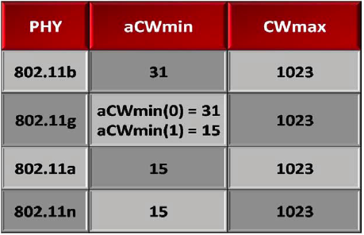
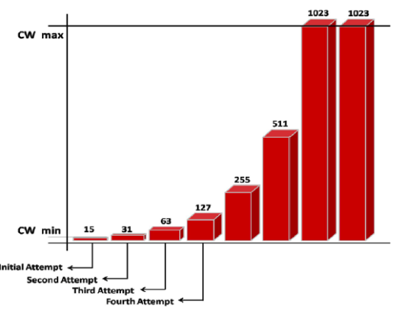
Contd...

Slide 15
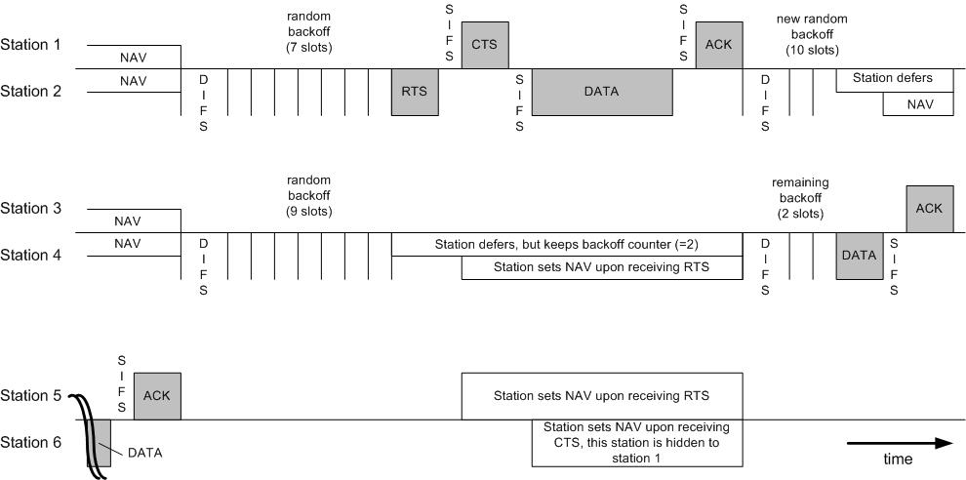
Frame Transmission

Slide 16
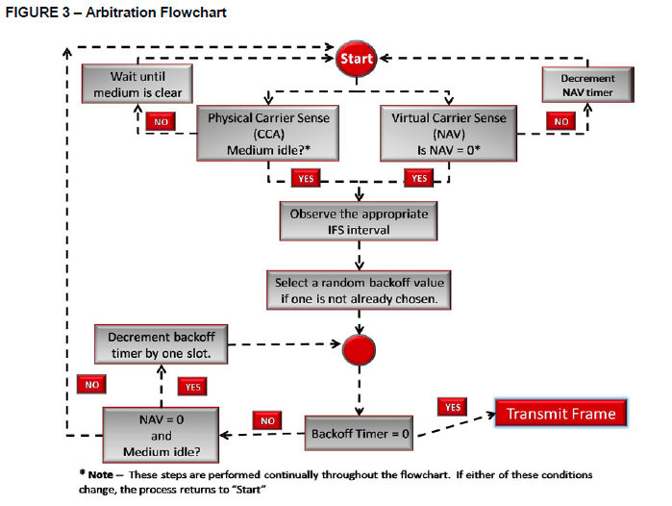
Arbitration Flowchart

